Slide 1
Manchester
Raspberry Jam 23
November 2014

Slide 2
Last Time...

Slide 3
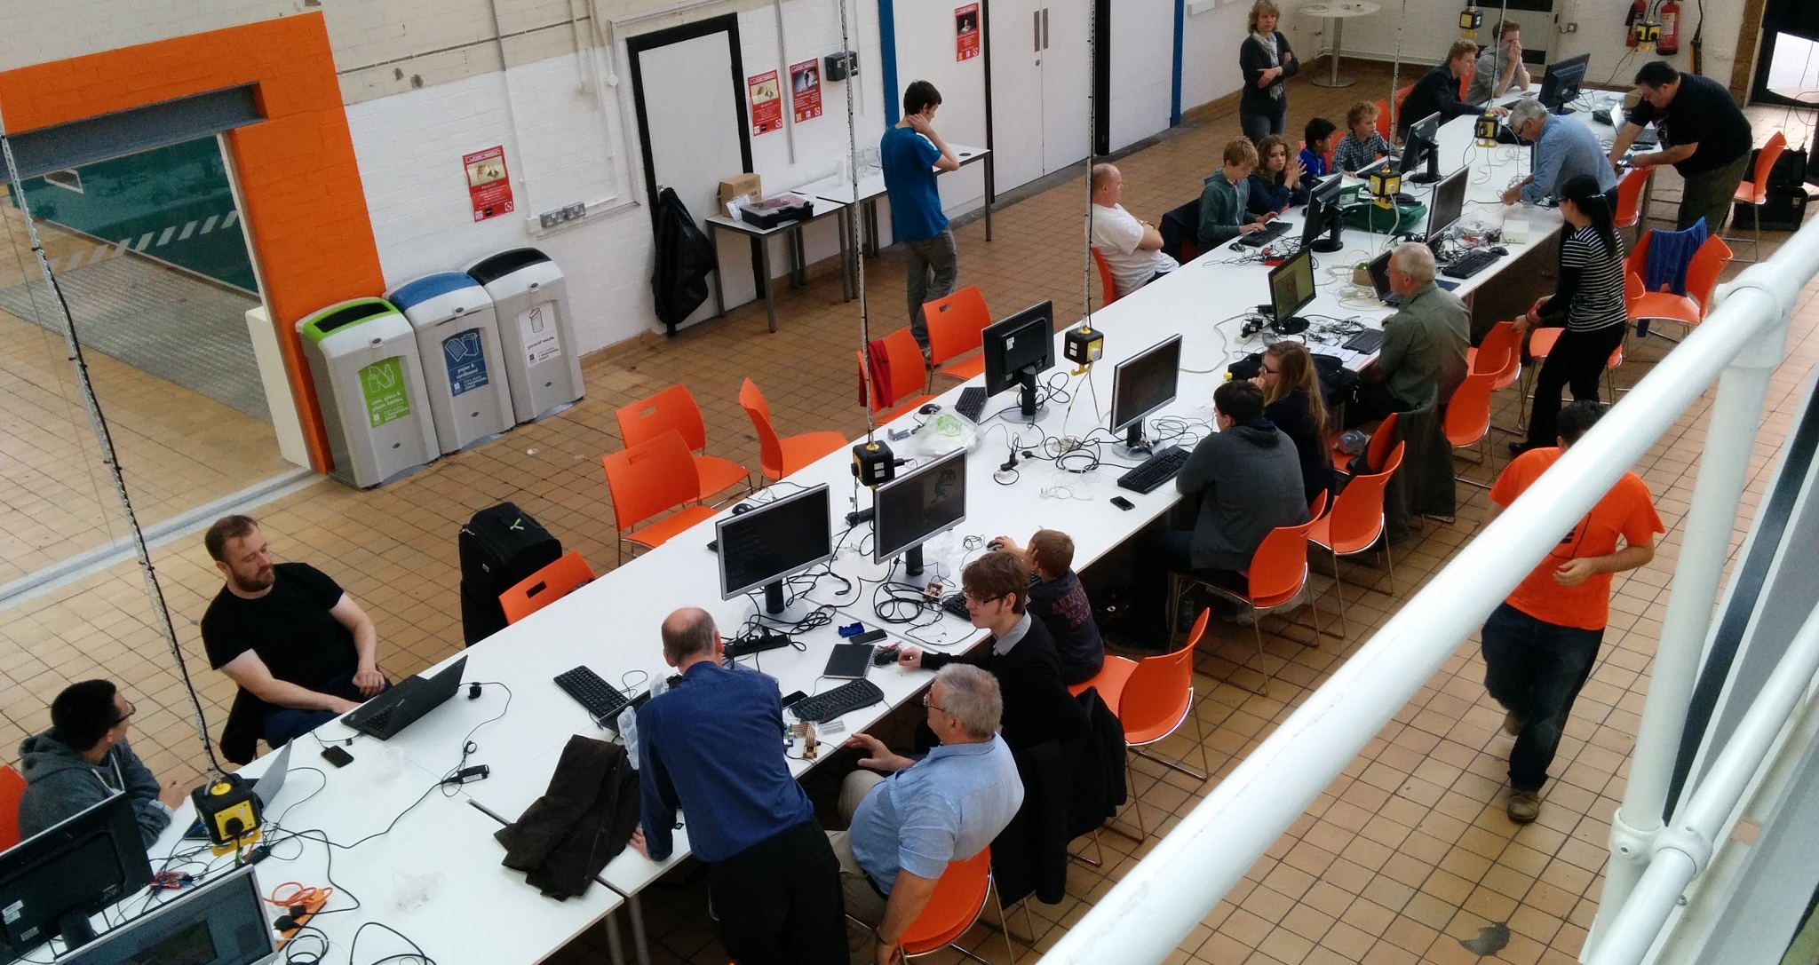
Manchester Raspberry Jam 22

Slide 4
In The News...

Slide 5

Spreading The Jam
http://www.raspberrypi.org/spreading-the-jam/

Slide 6
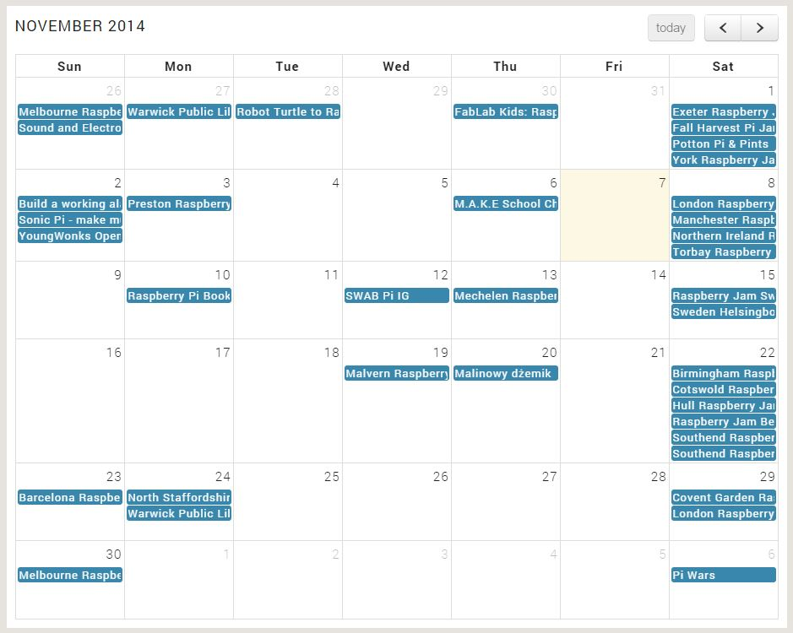
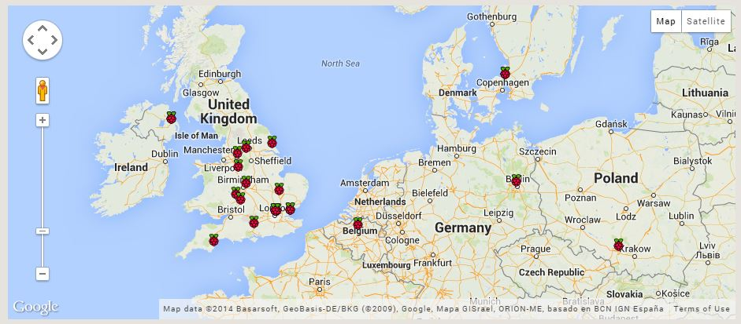

Spreading The Jam
http://www.raspberrypi.org/spreading-the-jam/

Slide 7
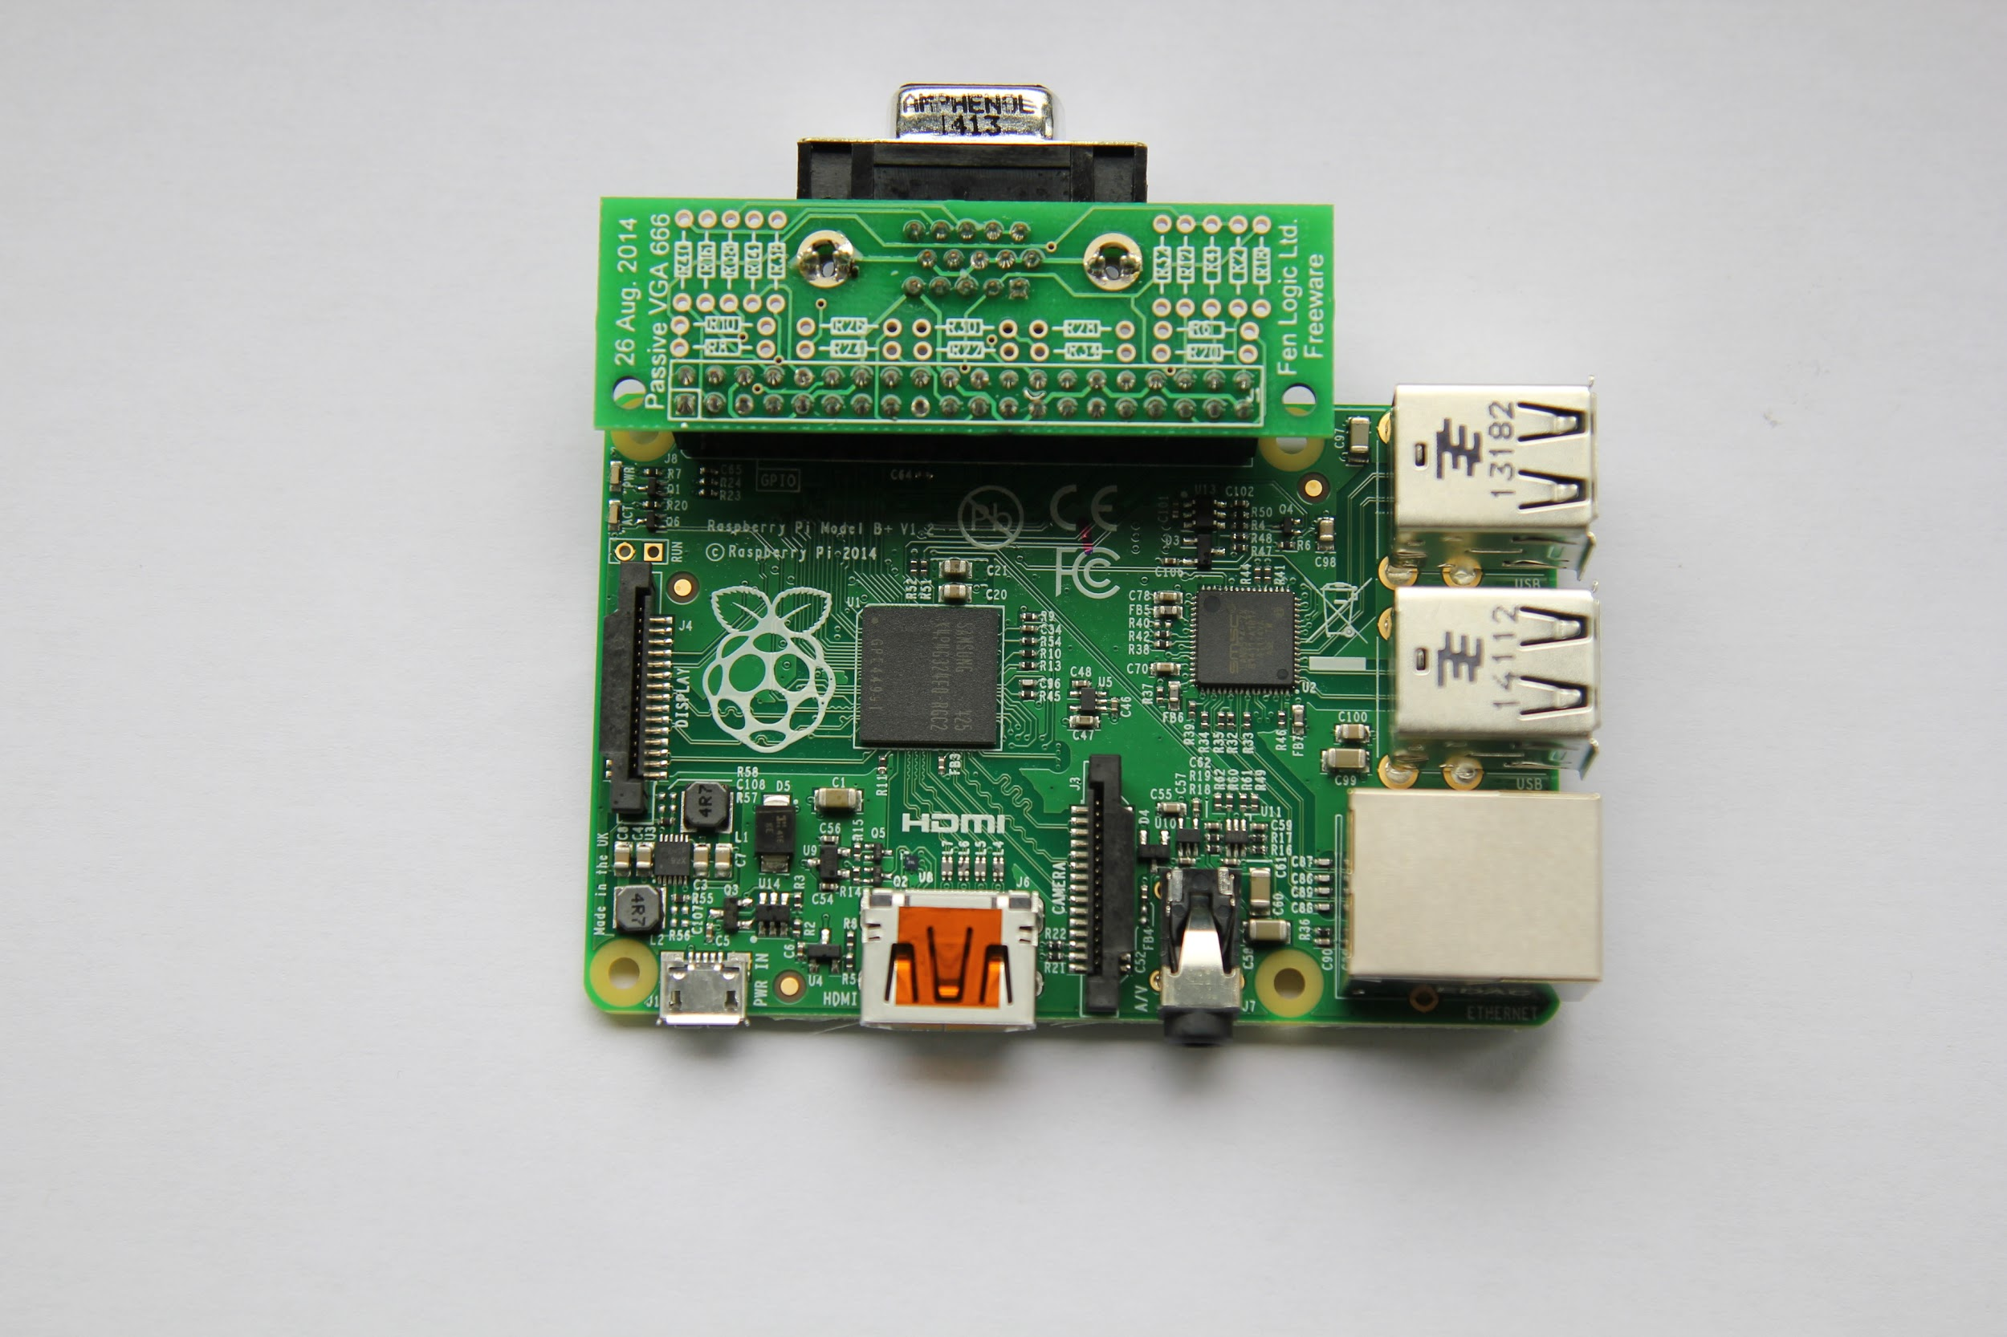
Gert’s VGA Adapter
http://www.raspberrypi.org/gert-vga-adapter/

Slide 8
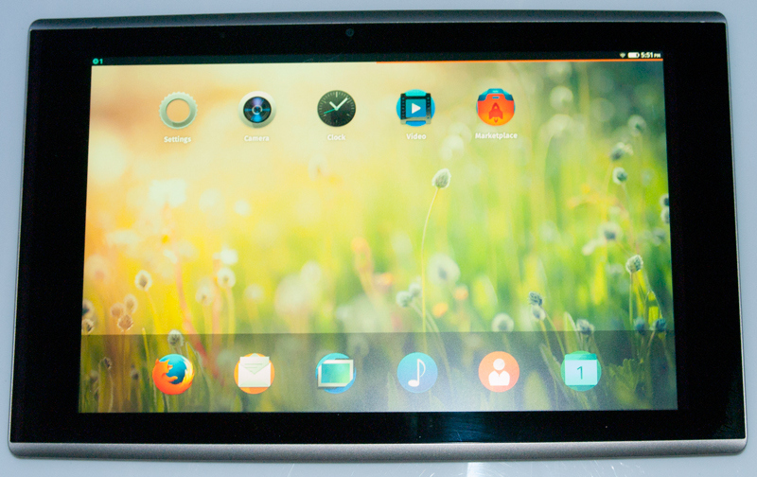
Firefox OS
https://wiki.mozilla.org/Fxos_on_RaspberryPi

Slide 9
Projects...

Slide 10
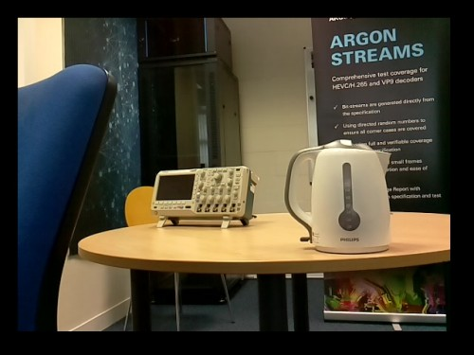
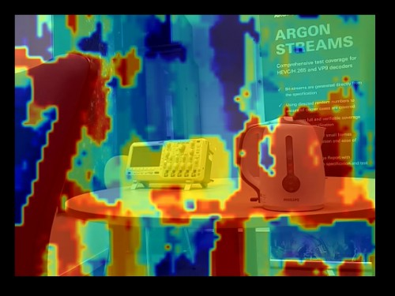
Depth Perception
http://www.raspberrypi.org/real-time-depth-perception-with-the-compute-module/

Slide 11
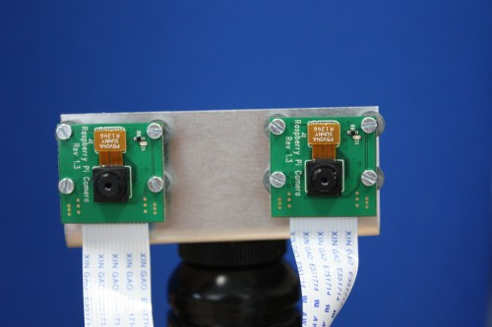
Depth Perception
http://www.raspberrypi.org/real-time-depth-perception-with-the-compute-module/

Slide 12
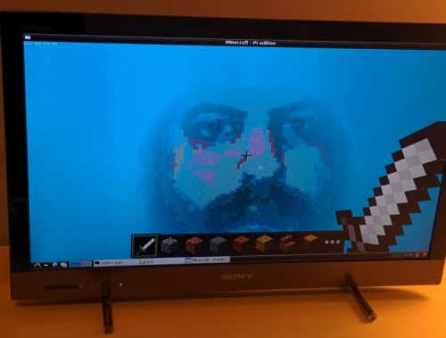
Camera Images in Minecraft
http://www.raspberrypi.org/rendering-camera-images-in-minecraft-in-real-time/

Slide 13
Coming soon...

Slide 14
Next Month...
Manchester Raspberry Jam 24
Saturday 6th December
mcrraspjam24.eventbrite.com
(Jam 25 - Sat 17th January)

Slide 15
For today...

Slide 16
Today:
Our first Workshop!
Getting Started with Raspberry Pi GPIO using Python
LED’s and other outputs
Switch inputs
LCD Displays
Starts at 11:30am

Slide 17
Today:
Pizza at 1pm
WiFi:
SSID MMU-Visitor
Pass. University

Slide 18
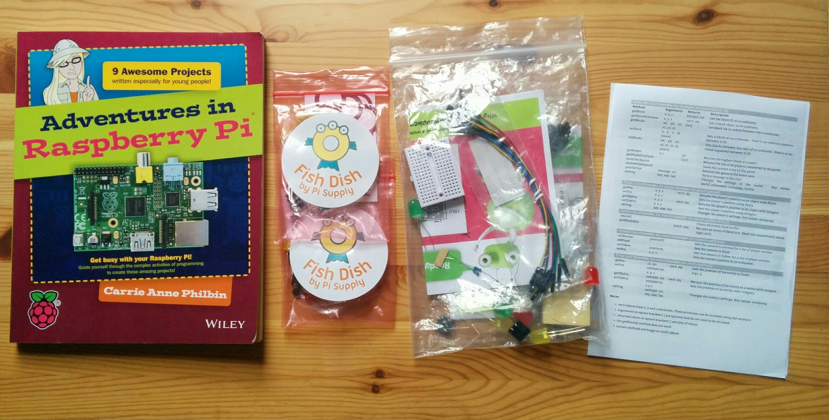
Stuck for ideas?
http://www.raspberrypi.org/introducing-raspberry-pi-model-b-plus/

Slide 19
Thanks to this month’s sponsors:
Christopher Harris
Colin Richardson
Rosemary Williams

Slide 20
Finally...
Tweet your photos and creations:
#McrRaspJam
Download the slides:
http://bit.ly/McrRaspJam23

